Slide 1
QUANTUM COMPUTING
MODELS

Slide 2
Learning Outcomes
By the end of this lesson, students will be able to:
Compare the three main QC models - gate-based, quantum annealing, and topological
Explain how gate-based QC uses quantum gates for universal computation
Describe quantum annealing principles and its optimization applications
Analyze topological QC error-resistant approach and its potential for stable qubits
Apply concepts to real-world cases

Slide 3
Types of QC Models
Model | What it does | Example use case
Gate-Based | Universal quantum circuits using gates | Shor’s Algorithm (breaking RSA)
Quantum Annealing | Finds best solutions via energy tunneling | Traffic optimization (Volkswagen)
Topological | Error-resistant using special particles | Robust quantum memory (future)

Slide 4
Gate-Based QC
WHAT IT IS
Most common model of QC
Allows general-purpose computation
Uses quantum gates (like logic gates but reversible)
KEY FEATURES
Hadamard (H) Gate: Creates superposition
CNOT: Entangles qubits
Supports complex algorithms like Shor’s and Grover’s

Slide 5
Hardware Example
TECHNOLOGY PLATFORMS
Superconducting Qubits: IBM, Google
Trapped Ions: IonQ
WHY IT MATTERS
Gate-based QC is programmable and scalable
Most ongoing quantum research uses this model

Slide 6
Use Cases
1 CRYPTOGRAPHY
2 CHEMISTRY
3 AI & ML
Shor’s Algorithm can break RSA encryption
Simulate Molecules
E.g. Lithium-ion battery design
Quantum neural networks for faster learning

Slide 7
Quantum Annealing
WHAT IT IS
Specialized quantum computing method
Solves optimization problems by finding the lowest energy state
KEY CONCEPTS
Quantum Tunneling
Skips over "bad" solutions
Adiabatic Evolution
Slowly changes the system to reach the “best answer”

Slide 8
How it Works
1. Problem Encoding | Translate your problem into an energy system (Hamiltonian)
2. Initial State | Start with an easy-to-solve setup
3. Adiabatic Evolution | Slowly change system to reflect your real problem
4. Quantum Tunneling | Escape local traps and find the global minimum
5. Final State | The lowest energy = best solution

Slide 9
Hardware Example
D-WAVE ADVANTAGE SYSTEM
5,000+ flux qubits
Requires cryogenic cooling
Built specifically for optimization tasks
COMPANIES USING IT
Volkswagen
Lockheed Martin
DENSO

Slide 10
Use Cases
1 Volkswagen
2 Finance
3 Pharmaceuticals
Traffic flow optimization
20% faster routing
Portfolio balancing
JPMorgan experiments
Protein folding
E.g. Covid-19 spike protein discovery

Slide 11
Topological QC
WHAT IT IS
Uses anyons (particles) in 2D systems
Quantum data is stored in topological features → makes it error-resistant
HOW IT WORKS
Swapping anyons changes the system’s quantum state
Computation = how you braid them (like tying quantum knots)
E.g. Braiding anyons can implement a CNOT gate

Slide 12
Hardware Example
TOPOLOGICAL SUPERCONDUCTORS
MAJORANA ZERO MODES
Experimental purposes
MAJORANA PROJECT
Microsoft is actively researching this

Slide 13
Use Cases
1 quantum memory
2 secure communication
Long-term storage that resists noise
Tamper-proof keys (future potential)
3 cryptography
2 MATERIAL SCIENCE
Could break RSA once scalable anyons exist
Simulate exotic topological phases

Slide 14
Feature | Gate-Based | Annealing | Topological
Operation | Quantum Gates | Energy Minimization | Anyon Braiding
Hardware | Superconductors/ Ions | D-Wave’s flux qubits | Majorana zero modes
Error Handling | Needs error correction | Noise-sensitive | Topologically protected
Flexibility | Universal | Optimization-only | Universal (potentially in future)

Slide 15
Model | Pros | Cons
Gate-Based | Runs all quantum algorithms Mature platforms (IBM Q, Qiskit) Useful for cryptography, chemistry, AI | Needs error correction Sensitive to noise Expensive, complex hardware
Quantum Annealing | Solves optimization problems well Commercially available (D-Wave) Fast for specific tasks | Not universal Less flexible Limited to niche problems
Topological | Highly error-resistant Great for long-term quantum memory Fault-tolerant design | Still experimental Hardware limited (Majoranas) Not yet general-purpose

Slide 16

Key Takeaways
GATE-BASED
Universal, programmable (general-purpose quantum computing)
ANNEALING
Fast solutions for optimization (scheduling / logistics)
TOPOLOGICAL
Most future-proof and error-resistant (once matured)

Slide 17

SECURE CHAT APP USING PQC

Slide 18
System Architecture Overview
1) TECH STACK
Frontend: React
Key Exchange: Kyber768 (quantum-resistant)
Encryption: AES-256-GCM (symmetric)
2) KEY EXCHANGE
Kyber768 creates a shared key between two users
Post-quantum secure (resists Shor’s algorithm)

Slide 19
System Architecture Overview
3) MESSAGE ENCRYPTION
Shared key is used in AES-256-GCM
All chat messages are securely encrypted
User’s information are also encrypted
4) WHY IT MATTERS
Traditional RSA could be broken by quantum computers
Kyber768 is quantum-safe and ready now

Slide 20
Kahoot Quiz
https://create.kahoot.it/share/updated-qc-intro/214d716c-a95a-4ee7-97a1-2b43241c0b67

Slide 21
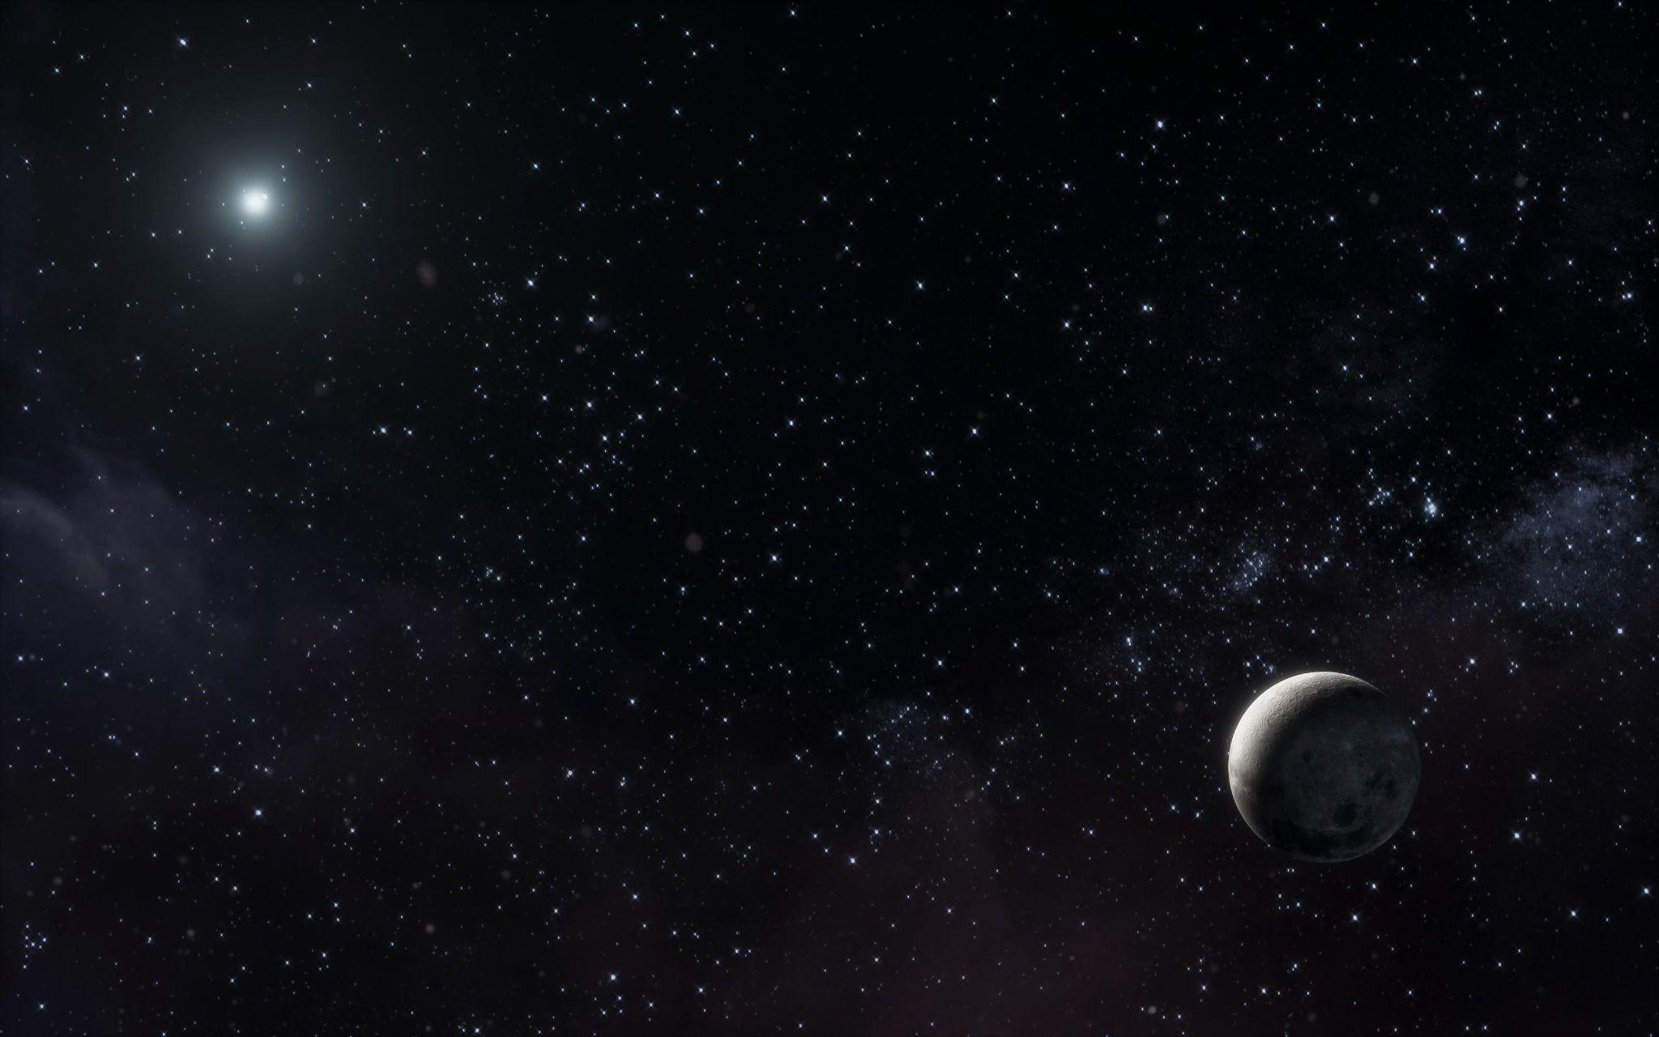
References
Quantum Zeitgeist. What is Quantum Annealing? (2023) https://quantumzeitgeist.com/what-is-quantum-annealing/
D-Wave Systems. What is Quantum Annealing? https://www.dwavequantum.com/learn/quantum-computing
Nature. Protein Folding via Quantum Annealing (2021) https://www.nature.com/articles/s41598-021-83503-7
arXiv. Quantum Tunneling in Optimization (2020) https://arxiv.org/abs/2006.03069
Wikipedia. Topological Quantum Computer. (2024)
https://en.wikipedia.org/wiki/Topological_quantum_computer

Slide 22
References
Simon, S. H. Topological Quantum Computing. Princeton University Lecture Notes (n.d.) https://www.princeton.edu/~sondhi/misc/simon.pdf
ResearchGate. Braiding of Anyons in a Topological Quantum Computer – Time Points Diagram (2018) https://www.researchgate.net/figure/A-demonstration-of-braiding-anyons-in-a-topological-quantum-computer-Time-points_fig1_325612286
ResearchGate. Braiding of Anyons – Trajectory Representation (2019) https://www.researchgate.net/figure/Representation-of-the-braiding-of-anyons-trajectories_fig3_333248280
Quantum Explainer. Topological Quantum Computing Explained Simply. (2023) https://quantumexplainer.com/topological-quantum-computing/
Freedman, M. H., et al. Topological Quantum Computation. Bulletin of the American Mathematical Society, Vol. 55, No. 2 (2018) https://www.ams.org/journals/bull/2018-55-02/S0273-0979-2018-01605-4/S0273-0979-2018-01605-4.pdf

